Slide 1


Weather Station
Processing Data in Kafka with Spark Structured Streaming
The Internet of Things: Big Data Processing and Analytics Instructor: Hinkmond Wong
Sheetal Gangakhedkar
November 21, 2017

Slide 2
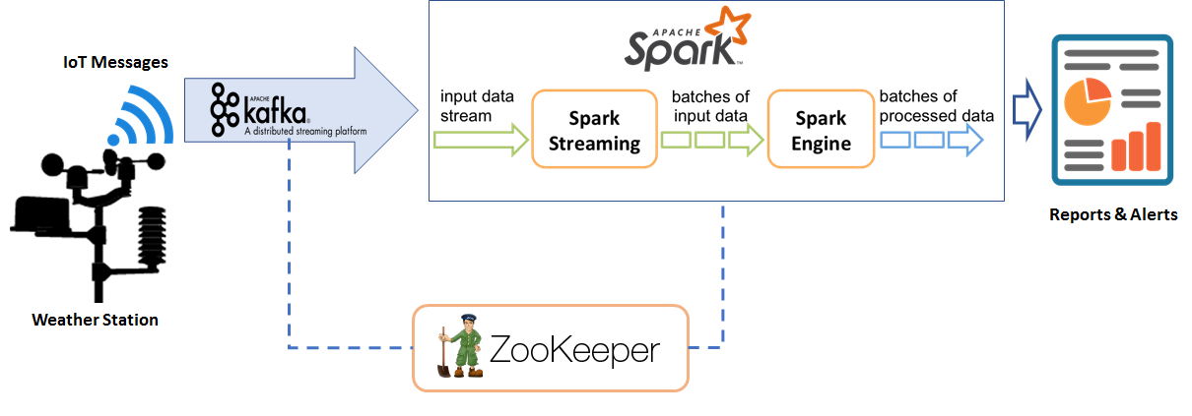

Architecture
Notes:
‹#›

Slide 3
Objectives
Analyze temperature and wind-speed sensor “weather station” data sent hourly. The objective is to analyze this streaming data and generate reports, that includes the following statistics:
Average, Min, and Max daily temperatures
Average, Min, and Max weekly temperatures
Average, Min, and Max temperatures for the full batch of data received
Average, Min, and Max daily wind-speeds
Average, Min, and Max weekly wind-speeds
Average, Min, and Max wind-speeds for the full batch of data received
NOTE: End with demo of Databrick PySpark Notebook

Slide 4
IoT Message Format
{
"guid":"0-ZZZ12345678-01A",
"destination":"0-AAA12345678",
"location":[
37.312125,
-121.757265
],
"eventTime":"2017-11-01T22:55:52.928972Z",
"payload":{
"format":"urn:example:sensor:temp",
"data":{
"temperature":53.5,
"windspeed":1.9
}
}
}
IoT Simulator Usage
# generate hourly temperature & wind-speed data for last 24 hrs
./iotsimulator.py 24
# generate hourly temperature & wind-speed data for last 10000 hrs
./iotsimulator.py 10000

Slide 5
Results
Show Weekly IoT Sensor Stats
+----------------+---------------------+-----------------------------+-------------------------------------+
| guid | window | min(temp)| max(temp)| avg(temp)| min(windspeed)| max(windspeed)| avg(windspeed)|
+----------------+---------------------+-----------------------------+-------------------------------------+
|0-ZZZ12345678-01A|[2017-11-16 00:00...| 44.3 | 65.0 | 50.75 | 0.1 | 10.9 | 5.789 |
+----------------+---------------------+-----------------------------+-----------------------------+-------+
Show Daily IoT Sensor Stats
+----------------+---------------------+-----------------------------+-------------------------------------+
| guid | window | min(temp)| max(temp)| avg(temp)| min(windspeed)| max(windspeed)| avg(windspeed)|
+----------------+---------------------+-----------------------------+-------------------------------------+
|0-ZZZ12345678-01A|[2017-11-16 00:00...| 45.2 | 64.4 | 53.47 | 1.3 | 10.9 | 4.922 |
|0-ZZZ12345678-01A|[2017-11-17 00:00...| 45.4 | 57.6 | 49.99 | 0.3 | 10.8 | 5.637 |
|0-ZZZ12345678-01A|[2017-11-18 00:00...| 44.3 | 63.6 | 51.61 | 0.2 | 10.8 | 6.312 |
|0-ZZZ12345678-01A|[2017-11-19 00:00...| 44.7 | 65.0 | 50.84 | 0.1 | 10.9 | 5.245 |
|0-ZZZ12345678-01A|[2017-11-20 00:00...| 45.0 | 59.8 | 49.19 | 0.8 | 10.2 | 6.415 |
+----------------+---------------------+-----------------------------+-------------------------------------+
Show SUMMARY of IoT Sensor temperature data
+-------+-----------------+
|summary| temperature|
+-------+-----------------+
| count| 100|
| mean| 50.75|
| stddev|4.797168777813462|
| min| 44.3|
| max| 65.0|
+-------+-----------------+
Show SUMMARY of IoT Sensor windspeed data
+-------+------------------+
|summary| windspeed|
+-------+------------------+
| count| 100|
| mean| 5.789000000000002|
| stddev|3.4867684961084726|
| min| 0.1|
| max| 10.9|
+-------+------------------+

